Slide 1
Project Deliverables 1
Group 3 - Imaim
Quinn Miller, Zhizhe Han, Zhiyi Ye, Claire O’Neil

Slide 2
Sprint Plan
We plan to complete two to three user stories each week to finish a total of 14 user stories that will make up our project.
Functionality of the program after each week:
Week 1: be able to create admin accounts, create user accounts
Week 2: be able to add profile pictures to accounts; add stories in the format of movie, TV show,
video game, comic, etc.; specifying the format, universe and genre of each story
Week 3: be able to add universes, add characters to specific stories and add pictures

Slide 3
Sprint Plan
Functionality of the program after each week:
Week 4: be able to review stories with a like/dislike button, view ratings on each story, and view
thoughts on each story
Week 5: be able to search for stories with a search bar and add existing stories to new universes
Week 6: be able to like/dislike thoughts and browse through stories

Slide 4
Configuration Management Plan
Project description: Story time is an application that allows users and admins to contribute their opinion about fictional stories in the form of movies, TV shows, books, video games, comics, etc. Admins can add Stories and Users can rate and review them.
We are using GitHub for our repository
We will add each new bug or fix to the branch - Branch Per Task
We will release an updated version every week

Slide 5
Configuration Management Plan
Version Number or Label | Features /Bug fixes Included in version
1.0 | Users and admins can add account
1.1 | Add profile pictures and stories
1.2 | Add characters and pictures to story
1.3 | Reviewing stories
1.4 | Designing story and university pages
1.5 | Make search feature
1.6 | Add liking opinions and browsing stories by genre
Project leader will confirm changes and add them to main branch.

Slide 6
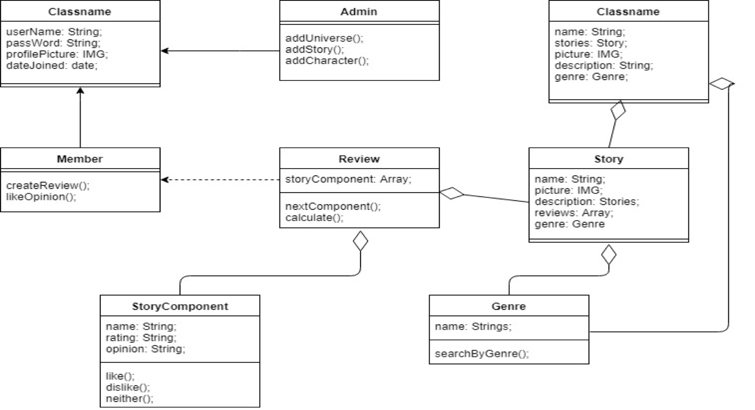
High Level Design Document
Illustrates how each class works together
-A Story can have a Genre
-A Review can contain a Story (with a Genre)
and a StoryComponent
-A Member creates a Review
-Users have a username, password, profile
picture and date joined
-A User can be an Admin
-A User can add a Story and a Genre

Slide 7
Software Requirements Document
Project Scope: Story time is an application that allows users to rate and share their opinion about the various story components and characters in fictional stories. These stories can be told in movies, TV shows, video games, books, comic books, or any type of literature.
Assumptions: Users must also be familiar with fictional stories and their components as to be able to review them and understand other users’ reviews. Anyone using the Story Time application must understand the how to navigate through basic program menus. The application should be relatively self-explanatory in nature and not leave assumptions to users.

Slide 8
Software Requirements Document
Specific Requirements: There are a number of functions that the Story Time application must execute. Admins and Members have to be able to make accounts and log into them. They can add pictures to their profiles. Admins must be able to add universes and stories to the application. These universes and stories will have their own page. Members can submit ONLY ONE review for each story. Universes contain stories. Stories can be added to universes even after they are created. Each story page will contain a review button where the review process begins. The review process will take the user through each component of the story (Introduction, plot, subplot, climax, resolution) and all the characters and the member will rate them (like, dislike, and neither) and have the option to leave an opinion along with their rating. Once the review is submitted, the member is returned to the story page. The story page will also contain modules for the story components and characters. Each module will contain three percentages: the percentage of members who liked that component/character, the percentage of members who disliked that component/character, the percentage of members who neither liked nor disliked that component/character. Each module will also contain a link that leads members to view all the opinions about that component/character. It will be a list which shows the profile picture of the member who left that opinion and the opinion itself. Members can like opinions and opinions will be ordered according how many likes they have with the most liked opinions being at the top. Users can search stories and universes by name or browse them according to genre .

